Slide 1


Island Detection for Grid-Connected Photovoltaic Distributed Generations via Integrated Signal Processing and Machine Learning Approach
Younis M. Nsaif, M.S. Hossain Lipu, Aini Hussain, Afida Ayob, Yushaizad Yusof
MD MAHFUZUR RAHMAN
2024.6.17

Slide 2
C
ONTENTS
1
Introduction
2
Background of the Problem
3
Proposed Solution
4
Result & Discussion
5
Conclusion

Slide 3
01
Intruduction

Slide 4
Introduction
Background
Photovoltaic Distributed Generations (PVDGs): With the growing demand for renewable energy sources, PVDGs have become increasingly common in distribution networks. They offer benefits such as cost-effectiveness, environmental sustainability, and enhanced reliability of the power supply.
Grid-Connected Systems: These systems are interconnected with the main power grid to ensure a stable supply of electricity. However, they must be carefully managed to maintain grid stability and safety.
Problem
Islanding: This is a condition where a section of the power grid becomes electrically isolated from the main grid but continues to be powered by distributed generators like PVDGs. Islanding can pose significant risks to both the equipment and personnel.
Detection Challenges: Timely and accurate detection of islanding is crucial to prevent potential hazards. According to the IEEE Standard 1547-2003, islanding detection should occur within 2 seconds to ensure safety. Traditional methods can struggle with accuracy and speed, especially in complex and dynamic grid environments.
Objective
Propose a Solution: The paper introduces a novel approach combining Variational Mode Decomposition (VMD) and the Ensemble Bagged Trees Method (EBTM) to enhance island detection.
Goals: Improve detection speed, reduce the non-detection zone (NDZ), and ensure high accuracy. Additionally, the solution aims to minimize power consumption and hardware requirements.
Significance
Reliability and Safety: By improving island detection, the proposed method helps maintain the reliability and safety of the power grid.
Efficiency: The integration of advanced signal processing and machine learning techniques can lead to more efficient and adaptive grid management.
Innovation: Leveraging VMD and EBTM represents a significant advancement in the field, offering robust performance in varying operational conditions.

Slide 5
02
Background of the problem

Slide 6
Background of the Problem
Growing Use of Photovoltaic Distributed Generations (PVDGs)
PVDGs are increasingly integrated into distribution networks for enhanced reliability and cost-effectiveness.
They contribute to environmental sustainability by leveraging renewable energy sources.
Grid-Connected Systems
These systems need to operate in synchrony with the main power grid to ensure a stable and reliable electricity supply.
Proper management is crucial to maintain grid stability and safety.
Islanding in Power Systems
Islanding occurs when a section of the grid is isolated but remains powered by local DGs.
This poses significant safety and operational challenges, requiring rapid and accurate detection and mitigation.

Slide 7
03
Propose Solution

Slide 8

Proposed Solution
1. Variational Mode Decomposition (VMD)
Purpose: Decompose voltage and power signals into intrinsic mode function (IMFs)
Benefits: Noise resistance, no mode minxing, suitable for non-stationary signals.
Process: Decompose positive and negative sequence voltage components
2. Ensemble Bagged Trees Method (EBTM)
Purpose: Classify the decomposed signals into islanding and non-islanding events.
Benefits: High accuracy, robust to overfitting, effective with large datasets.
Process:Train the model using extracted features from VMD.
Test the model to validate its accuracy and reliability.
3. Island Detection Algorithm
Purpose: Integrate VMD, and EBTM into a cohesive detection system.
Benefits: Ensures robust and efficient islanding detection.
Process:
Pre-process signals using VMD.
Apply sliding-window analysis to segment the signal.
Classify segments using EBTM.
Detect and respond to islanding events in real-time.

Slide 9


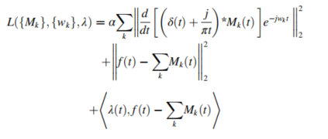
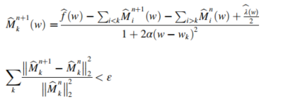
VMD Decomposition
VMD is applied to obtain the prominent features in the time frequency domain, that have multiple benefits, such as being self adaptive, noise-resistant, and having no effect on mode mixing. Multi component signal decomposition, identification of sidebands, extraction of intra-wave characteristics, and noise robustness are all fields where the VMD surpasses the empirical-mode decomposition. Therefore, features of the signal were extracted using VMD instead of empirical-mode decomposition.
The IMFs sinewave function
A new Lagrangian-multiplier is calculated as
The decomposition problem for every signal eqation
The updated values for the centre frequency and the evaluated modes in the frequency

Slide 10
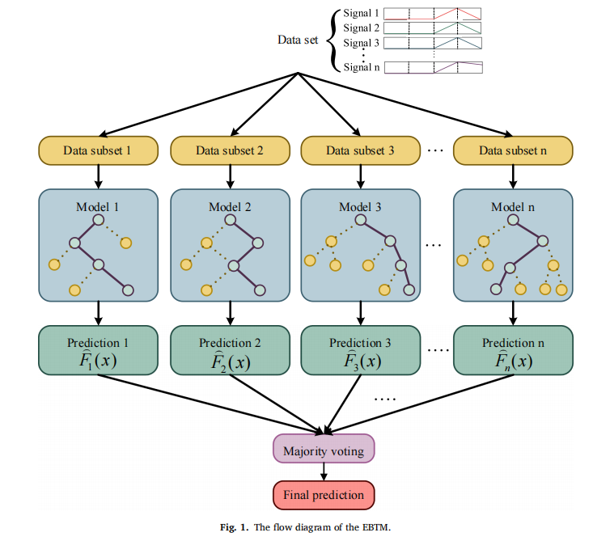
Essemble Bagged Trees Methods

Slide 11
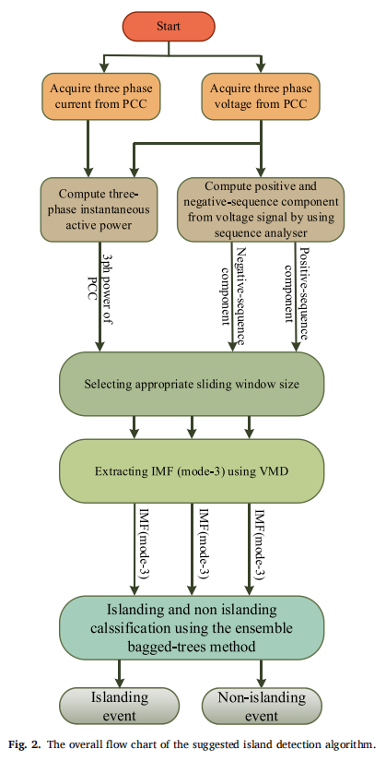
Island Detection Algorithm

Slide 12
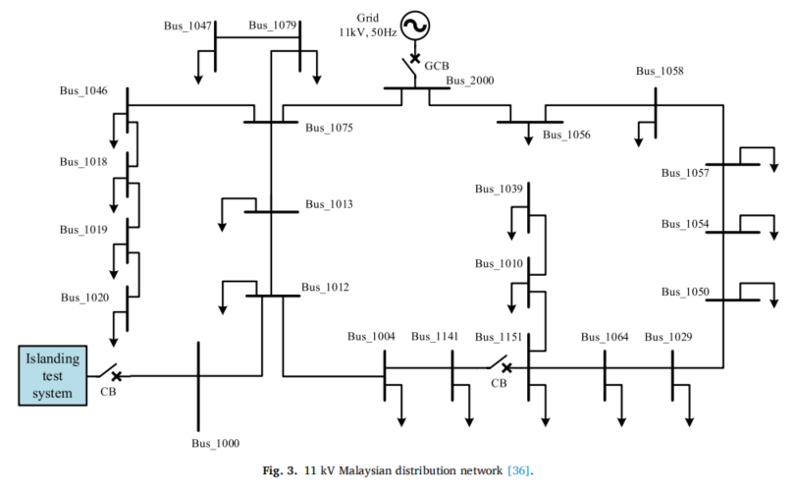
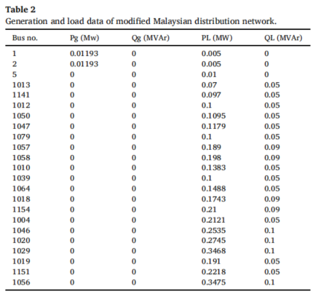
The Test System

Slide 13
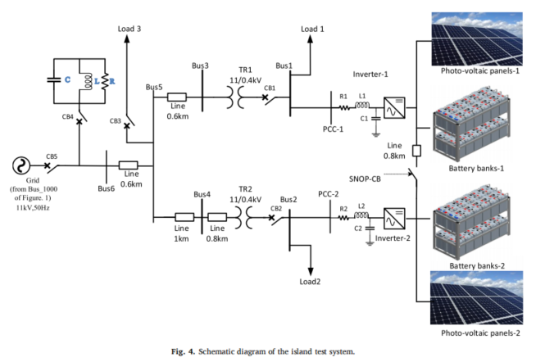
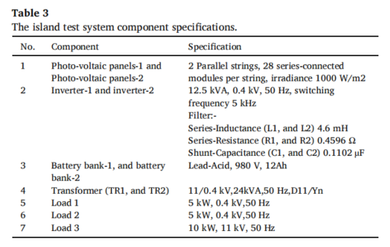
The Test System

Slide 14
04
Result and Discussion

Slide 15
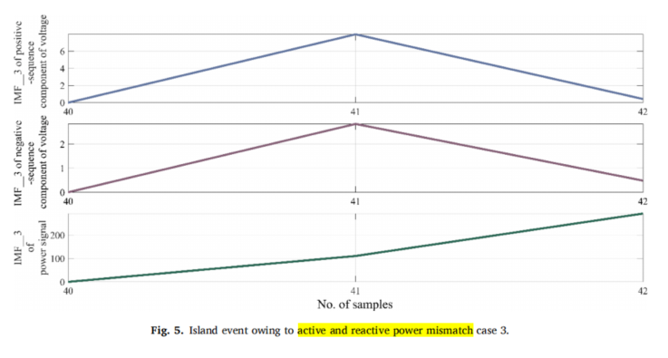
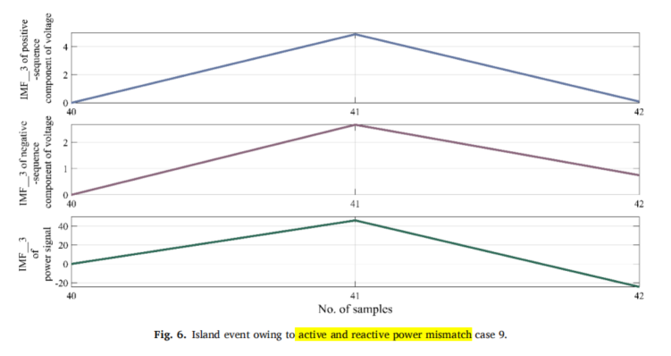
Active and Reactive Power Mismatch

Slide 16
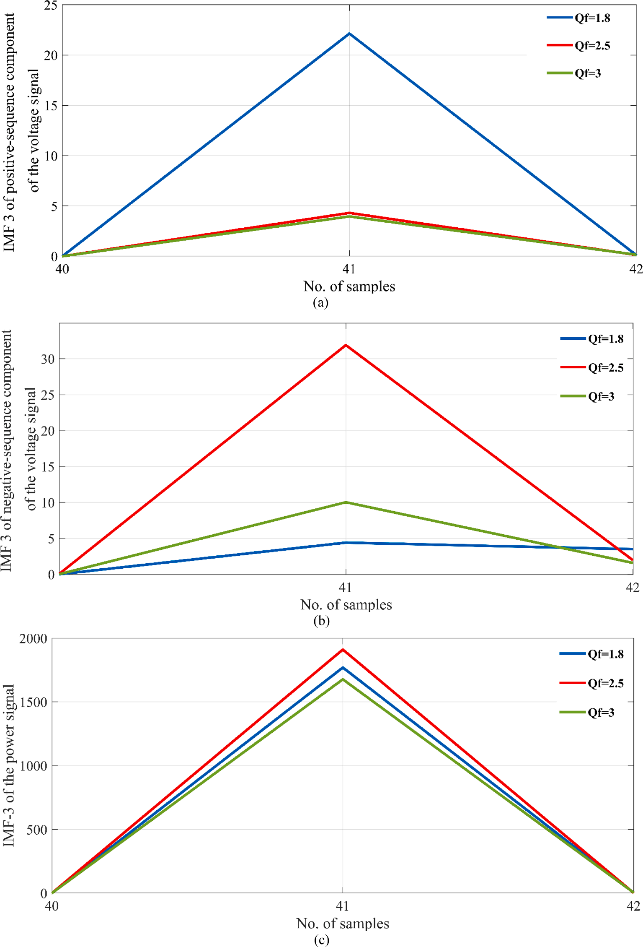
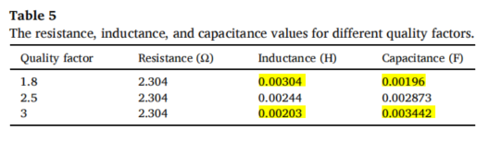
Inconvenient quality factor
(a) IMF_3 of the positive sequence component of the voltage signal,
(b) IMF_3 of the negative sequence
component of the voltage signal, and
(c) IMF_3 of the power signal.
Figure 7. Variation of VMD IMF_3 during various quality factors

Slide 17
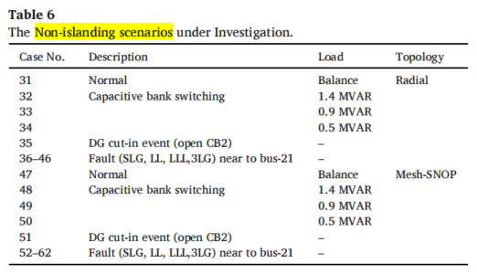
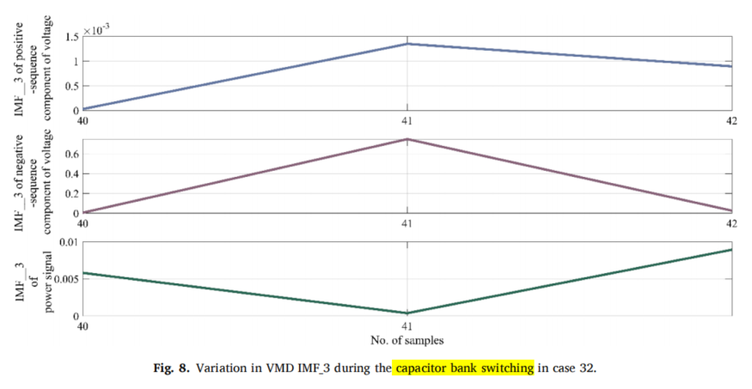

Slide 18
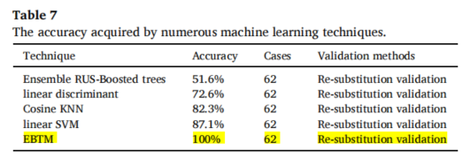
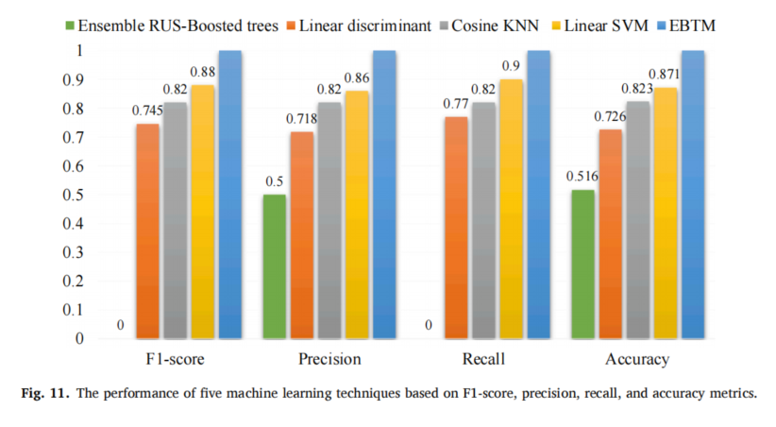
Performance

Slide 19
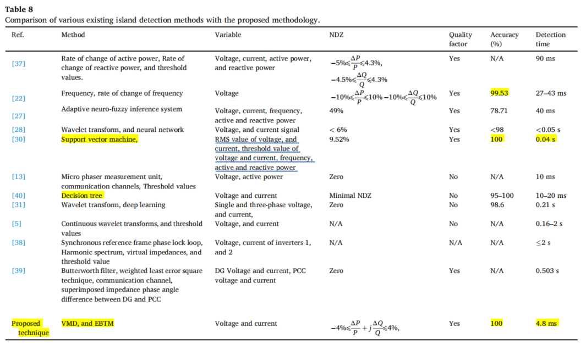
Comparison

Slide 20
05
Conclusion

Slide 21
Conlcusion
This paper proposes a new Islan detection method for photovoltaic distributed generation.
Both the signal processing and machine learning technique are used in the proposed. positive and negative sequence component voltage signals, as well as power signals, are processed with variational mode decomposition to acquire hidded features.
Afterwards, the ensemble bagged-trees method is applied to detect islanding. This proposed method is then compared with four traditional machine learning techniques such as ensemble random under-sampling-boosted trees, linear discriminant, K-nearest neighbours, and linear support vector machines.
The ensemble bagged trees method provides high performance in regards to F1-score, precision, recall, and accuracy(100%) metrics.
Based on extensive tests for a variety of events, the proposed technique is able to differentiate between islanding and non-islanding events such as capacitive switching, fault emulation, and distributed generation cut-in.
The proposed method is capable of detecting islanding during active and reactive power mismatch events and inconvenient quality factors in 4.8 ms.
Therefore, the proposed technique offers a high degree of dependability.

Slide 22
Thanks

